Slide 1
IRS Issued Identification Numbers ATINs and ITINs
Pub 4012 – Tab L
Pub 4491 – Lesson 4 and Lesson 8
Notes:
ATIN section is comprehensive
Applying for and Renewing ITINs section comprehensive

Slide 2
Lesson Topics
Adoption Taxpayer Identification Numbers
ATIN
Individual Taxpayer Identification Numbers
ITIN
Applying for and Renewing ITINs

Slide 3
IRS Issued Identification Numbers
ATIN – Adoption Taxpayer Identification Number
ITIN – Individual Taxpayer Identification Number
Used in place of social security number for IRS tax filings

Slide 4
Adoption Taxpayer Identification Numbers
Comprehensive
Notes:
This section is comprehensive

Slide 5
ATIN
Taxpayers need ATIN for their adoptive child if
In process of adopting child
Unable to get SSN for any reason
Able to claim child as dependent – or –
Able to claim child and dependent care credit
Notes:
Reference: https://www.irs.gov/individuals/adoption-taxpayer-identification-number
The child is legally placed in your home for adoption by an authorized placement agency.
The adoption is a domestic adoption OR the adoption is a foreign adoption and the child/children have a permanent resident alien card or certification of citizenship.
You cannot obtain the child's existing SSN even though you have made a reasonable attempt to obtain it from the birth parents, the placement agency, and other persons.
You cannot obtain an SSN for the child from the SSA for any reason. (For example, the adoption is not final).
Also see Pub 17, Chapter 1, page 12; Chapter 34, page 224

Slide 6
ATIN
Taxpayer submits Form W-7A with copies of required documents to IRS
IRS issues ATIN for child if
Final domestic adoption is pending and
Adopting taxpayers do not have child’s SSN
Mailed to IRS
4 – 8 weeks to process
Notes:
Copies (not originals) of the placement documents are required:
A placement agreement entered into between taxpayer and a public or private adoption agency.
A document signed by a hospital official authorizing the release of a newborn child to taxpayer for legal adoption.
A court order or other court document ordering or approving the placement of a child with taxpayer for legal adoption.
An affidavit signed by an attorney, a government official, etc., placing the child with taxpayer pursuant to the states' legal adoption laws.
The placement documentation is sometimes referred to as "Placement Agreement"; "Surrender Papers"; "Temporary Placement Paperwork"; "Placement Order" etc. This documentation termed differently from state to state must clearly establish that the child was placed in your (taxpayer’s) home for purposes of adoption by an authorized adoption agency (or agent), and must include the following information:
Adoptive Parent(s) full name
Child's full name
Name of the Placement Agency or Agent
The date the child was placed in the adoptive parent’s home.
The signature of the parent or parents (the adopting taxpayers) and that of an official representative of the authorized placing agency or agent.

Slide 7
ATIN
When the adoption becomes final
Adopting parents obtain SSN for child and
Notify IRS of new SSN
IRS will deactivate ATIN
IRS will deactivate ATIN automatically after two years
Extension can be requested if adoption not yet final

Slide 8
ATIN
Taxpayer should complete W-7A process
Taxpayer brings ATIN letter from IRS to tax appointment

Slide 9
ATIN
Nine-digit ATIN begins with number 9 and 93 in the middle
Use ATIN on return wherever child’s Social Security number requested

Slide 10
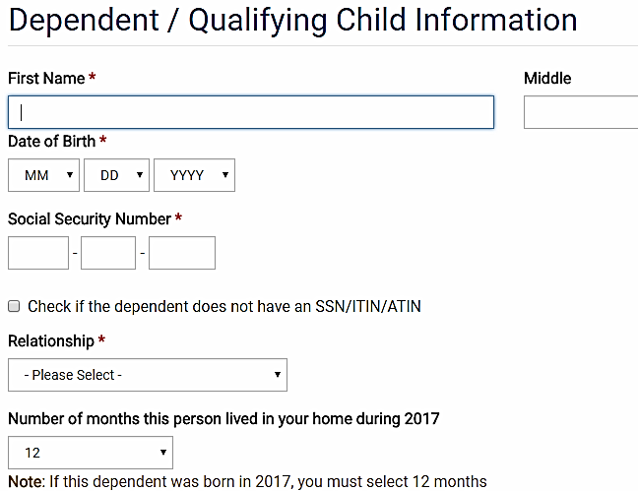
Taxpayer Has Child with ATIN
Navigation:
Basic Information>
Dependent/Qualifying Child Information
Use Other unless familial relationship exists

Slide 11
Taxpayer Has Child with ATIN
Can claim child or dependent care credit
Cannot claim child tax credit/additional child tax credit
child must be US citizen or resident with SSN
Can claim adoption credit – out of scope
Notes:
Assumes all other requirements are met
Social Security number required for Child Tax Credit (CTC). If CTC disallowed, child may be eligible for new $500 Credit for Other Dependents (COD). TaxSlayer will calculate and apply COD.

Slide 12
Taxpayer Has Child with ATIN
Cannot claim Earned Income Credit with ATIN
Can claim EIC with other qualifying children who have SSNs
TaxSlayer handles ATINs correctly

Slide 13
ATIN

Slide 14
Individual Taxpayer Identification Numbers
ITIN

Slide 15
ITIN
IRS issues ITIN to individual who must have U.S. taxpayer identification number
Do not have, and not eligible for, Social Security number (SSN)
ITIN is issued regardless of immigration status
ITIN is tax identification number for IRS only
ITIN is not a form of identification
Notes:
Emphasize
ITIN does not “legalize” an illegal immigrant
It does not confer a right to work
It merely provides an avenue for individuals to comply with the income tax laws
Also see Pub 17 Chapter 1

Slide 16
ITIN
ITINs begin with 9
Middle 2 digits are within certain numeric range set by IRS
TaxSlayer recognizes an ITIN when it is entered

Slide 17
Taxpayer with ITIN
Verify ITIN
IRS ITIN letter or
ITIN card
Notes:
17

Slide 18
Taxpayers with ITIN
Dependents must have ITIN, ATIN or SSN
Can claim child tax credit if child has SSN
Can claim credit for other dependents if child has ITIN or ATIN
Can claim child/dependent care credit
Cannot claim earned income credit
Notes:
Taxpayer with an ITIN cannot claim EIC even if qualifying children have SSN.

Slide 19
Child Tax Credit with ITIN
Cannot claim child tax credit or additional child tax credit
SSN required for credit
Can claim $500 nonrefundable credit for other dependents
Credit for certain qualifying children without social security number
ITIN or ATIN required for credit
Notes:
ITIN – individual taxpayer identification number assigned by IRS
ATIN- adoption taxpayer identification number assigned by IRS
Qualifying children must have SSN to claim child tax credit and additional child tax credit

Slide 20
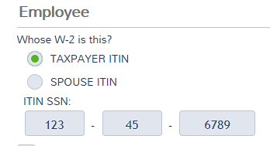
Taxpayer with ITIN
Taxpayer may be using a SSN that is not their own
W-2 may reflect that other SSN
Enter the other SSN on the W-2 as ITIN SSN
Notes:
TaxSlayer refers to other SSN as “ITIN SSN”

Slide 21
Taxpayer with ITIN
ITIN returns can be E-filed
Taxpayer and/or spouse have ITIN

Slide 22
Applying for and Renewing ITINs
Comprehensive
Notes:
This section is comprehensive material

Slide 23
Apply for ITIN
If no SSN nor ITIN for taxpayer, spouse or a dependent
Use “Apply for ITIN” option
Complete return with social security number of 000-00-0000
Return cannot be E-filed

Slide 24
Apply for ITIN
If all information available
add and complete Form W-7 for each person on the return who does not have an ITIN or SSN
If information not available at the time of tax preparation
give taxpayer blank Form W-7 to be completed at home
Notes:
24
To have future communication with IRS in Spanish, use W-7S
Limited exception to filing when no tax return is required
Effective 1/1/13, only acceptable documents are:
Passport (stand alone document)
National identification card (must show photo, name, current address, date of birth, and expiration date)
U.S. driver's license
Civil birth certificate (required for dependents under 18 years of age)
Foreign driver's license
U.S. state identification card
Foreign voter's registration card
U.S. military identification card
Foreign military identification card
Visa
U.S. Citizenship and Immigration Services (USCIS) photo identification
Medical records (dependents only – under 6, under 18 if a student)
School records (dependents only – under 14, under 18 if a student)

Slide 25
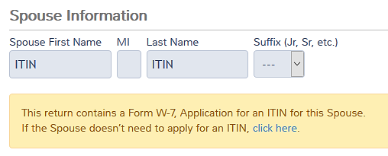
Apply for ITIN
After entering 000-00-0000 for taxpayer or spouse, TaxSlayer assumes W-7 will be filed

Slide 26
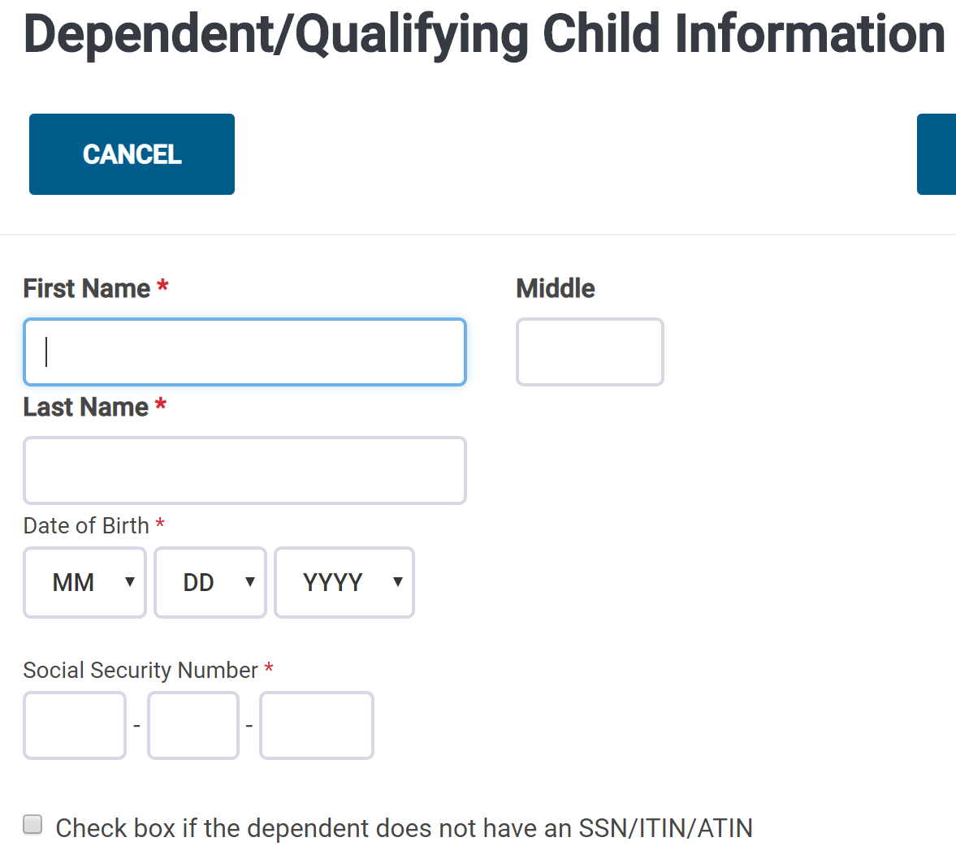
Apply for ITIN
For dependent, check box if no ITIN, ATIN or SSN

Slide 27
Apply for ITIN
Federal>Miscellaneous Forms>Application for ITIN (FormW-7)
find and complete for each person, as needed
Application for New or Renewal ITIN
Complete the multiple screens

Slide 28
Apply for ITIN
Attach required documents proving identity to paper return
Mail to address in W-7 instructions
Taxpayer can also walk documents into IRS Taxpayer Assistance Center or authorized acceptance agent
Notes:
28
To have future communication with IRS in Spanish, use W-7S
Limited exception to filing when no tax return is required
Effective 1/1/13, only acceptable documents are:
Passport (stand alone document)
National identification card (must show photo, name, current address, date of birth, and expiration date)
U.S. driver's license
Civil birth certificate (required for dependents under 18 years of age)
Foreign driver's license
U.S. state identification card
Foreign voter's registration card
U.S. military identification card
Foreign military identification card
Visa
U.S. Citizenship and Immigration Services (USCIS) photo identification
Medical records (dependents only – under 6, under 18 if a student)
School records (dependents only – under 14, under 18 if a student)

Slide 29
Apply for ITIN
IRS processing time 6 weeks (or more)
If a Social Security number is received:
Taxpayer should notify IRS
IRS will combine tax records under new SSN

Slide 30
Must Renew an ITIN
All ITINs issued before 2013 will begin expiring on rolling schedule
ITINs not used on a tax return in the last 3 years will begin expiring on rolling schedule

Slide 31
Must Renew an ITIN
Can renew ITIN (Form W-7) without filing a tax return
Can file return prior to renewing ITIN
no refund issued until ITIN renewed
Can renew all ITINs in the family with first to expire

Slide 32
Must Renew an ITIN
IRS will communicate with ITIN holders directly
Should not impact tax return filing
Notes:
32

Slide 33
Taxpayer Summary
ATIN and ITIN

Slide 34
Taxpayer Summary
Use ITIN or ATIN in place of SSN in TaxSlayer
If W-2 has a different number, enter different number on the W-2 screen

Slide 35
Taxpayer Summary
Provide taxpayer copy of W-7 forms and instructions if they need to complete them
Form W-7 is also available in Spanish

Slide 36
IRS Issued Identification Numbers

